Slide 1
Wood Trek-
Peter Jones
Going To Richmond-
Ricky Skaggs & Kentucky Thunder Instrumentals
June Apple-
Heartland Dulcimer Club

Slide 2
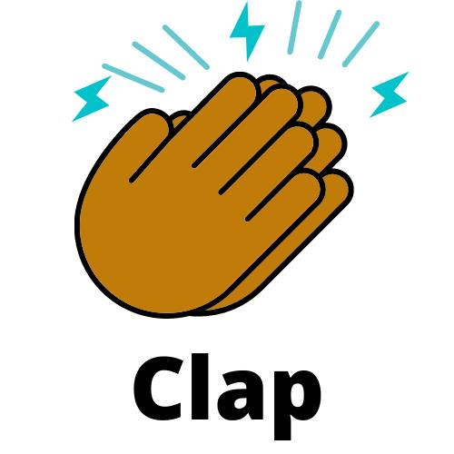
Clap 4 times

Slide 3
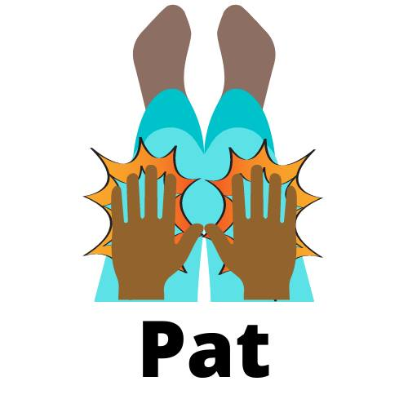
Patsch 4 times

Slide 4
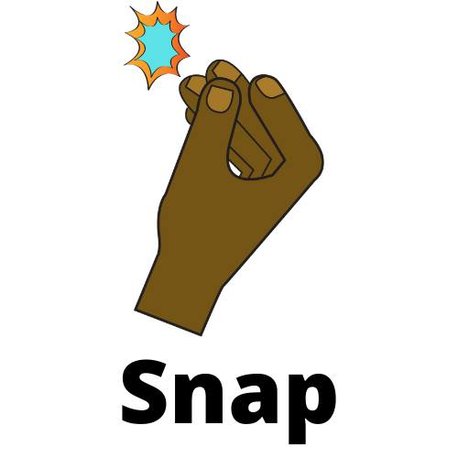
Snap 4 times

Slide 5
Alternate between clapping and patsch

Slide 6
Play each one time and repeat

Slide 7
What other non locomotor motions can you use?
Jump
dab
Swing (arms)
Stretch
Fly
sway
Hop

Slide 8
Adaptations
Remote learning
Socially Distanced settings

Slide 9
Let’s Dance….

Slide 10
Folk Dances for today
Zingeurner Polka
Cherkessia
Ersko Kolo
Alunelul
Chillili
D'Hammerschmiedsgsell'n
Los Machetes
Alewander

Slide 11
Thank you for inviting me to share with all of you from Louisville!

