Slide 1


Slide 2
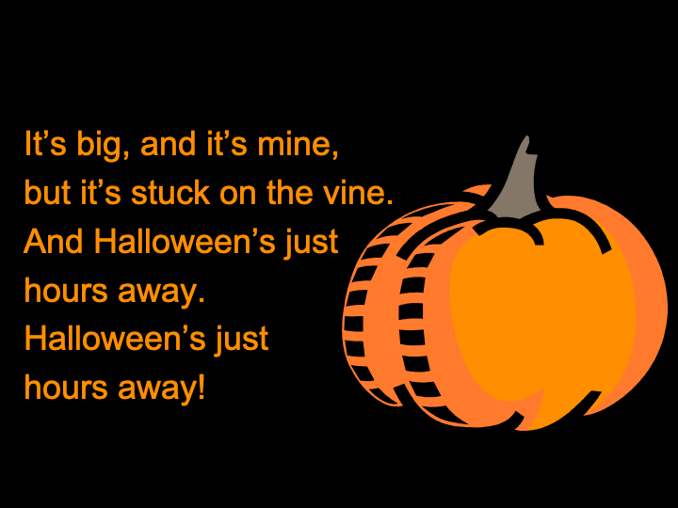

Slide 3
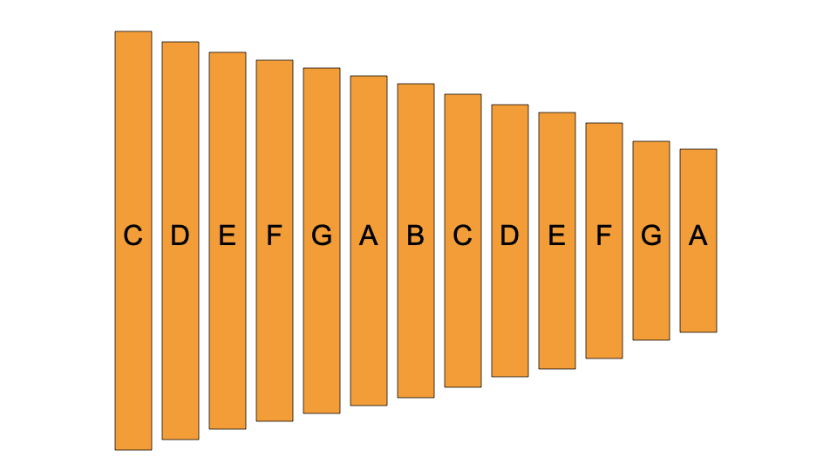

Slide 4
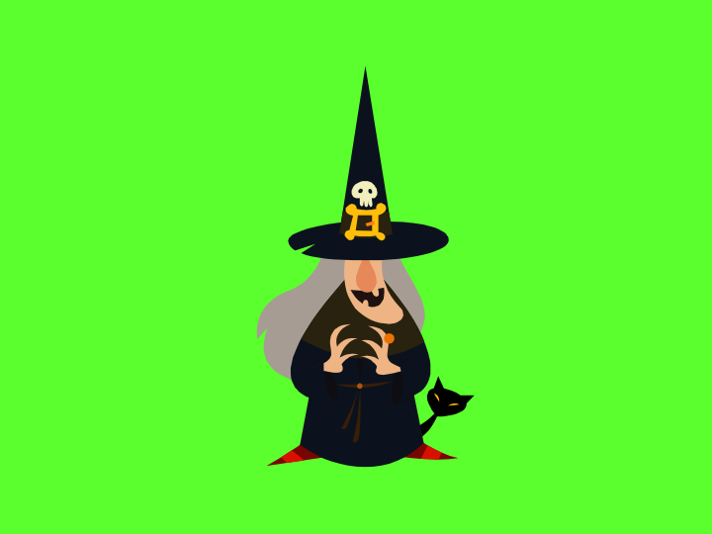

Slide 5
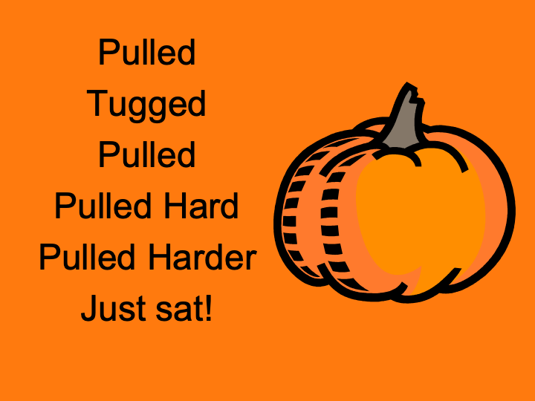

Slide 6
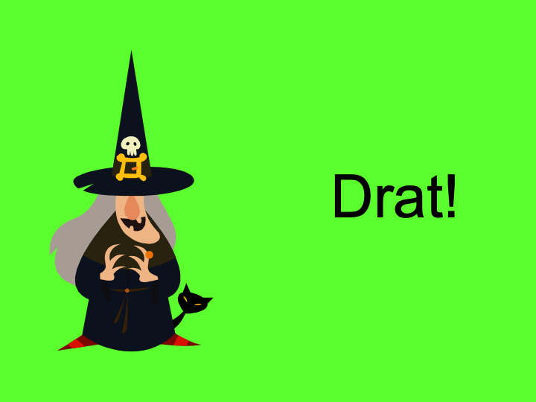

Slide 7


Slide 8


Slide 10
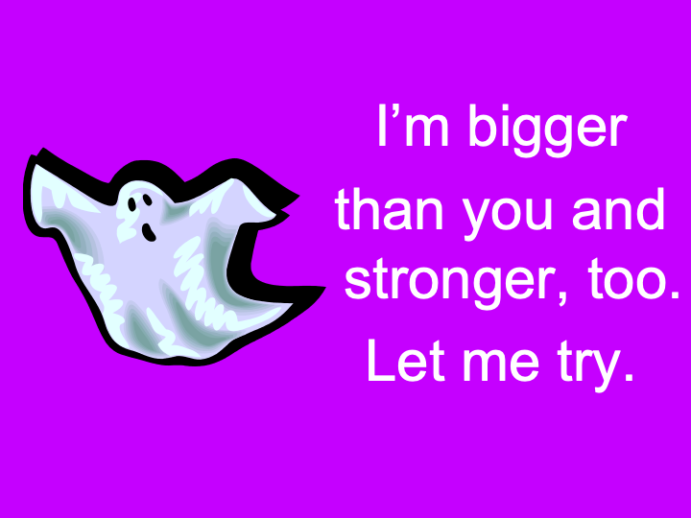

Slide 11
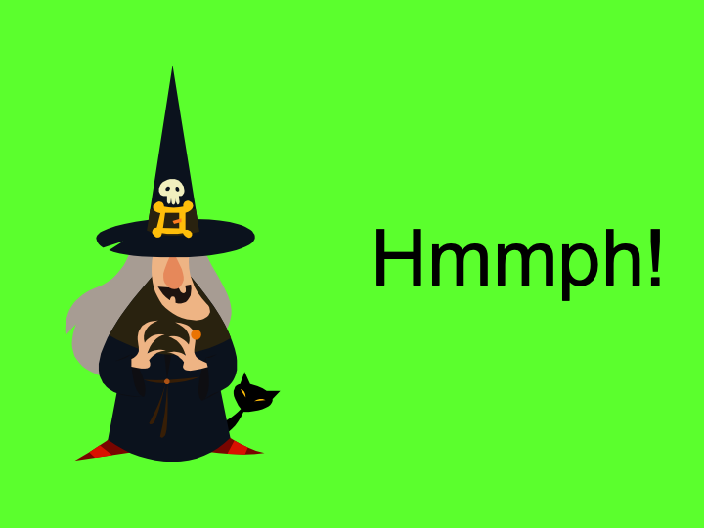

Slide 13


Slide 14
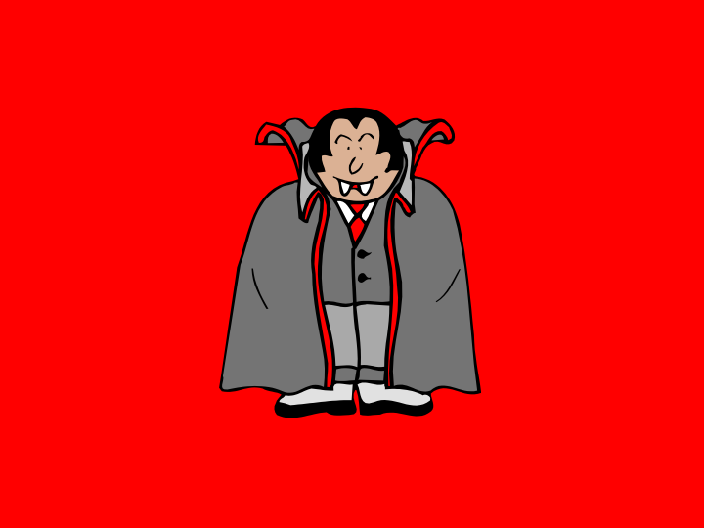

Slide 15
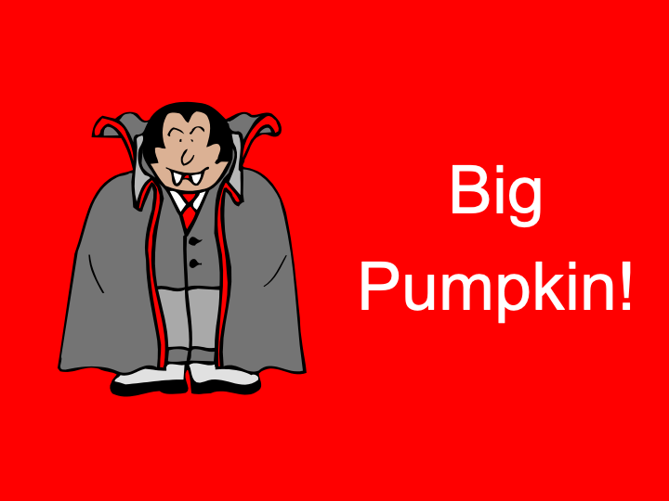

Slide 17
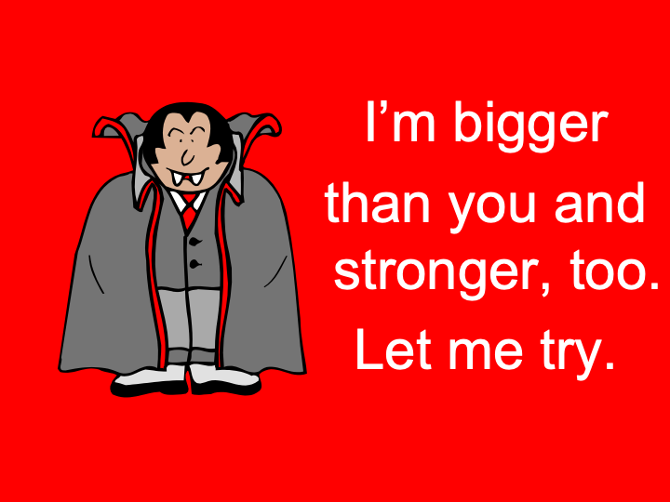

Slide 19


Slide 21
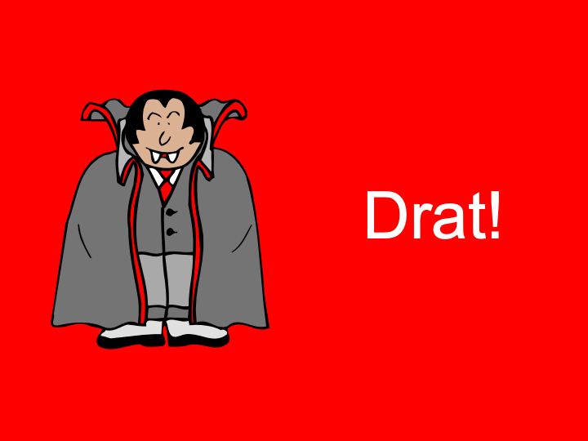

Slide 22
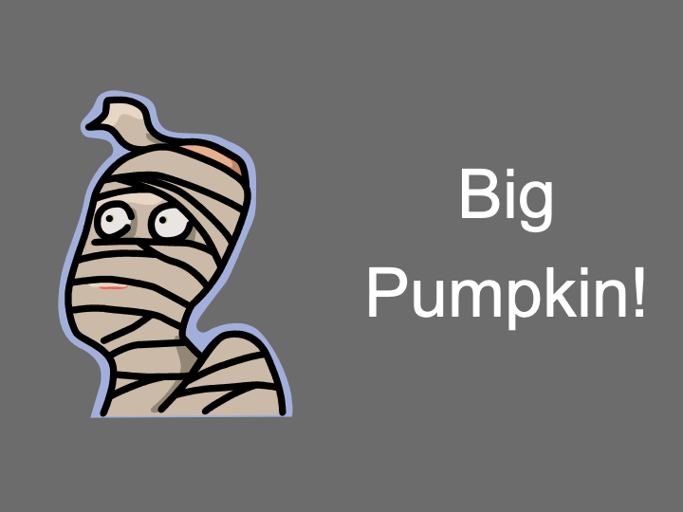

Slide 24
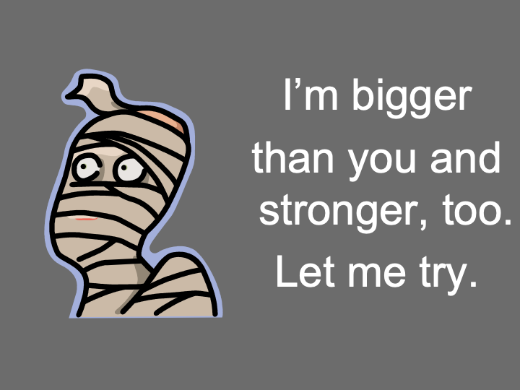

Slide 27
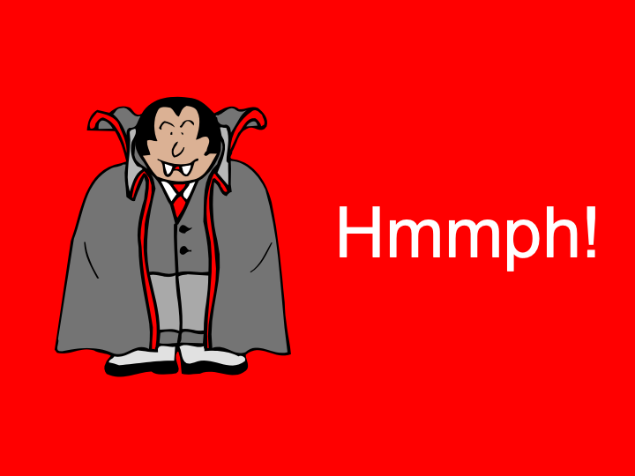

Slide 29
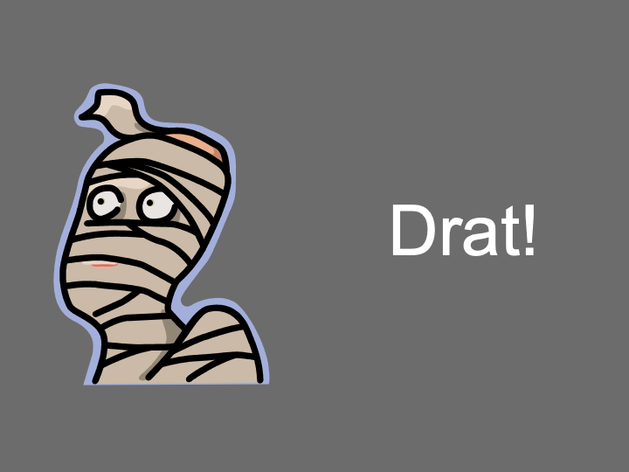

Slide 30


Slide 31


Slide 32
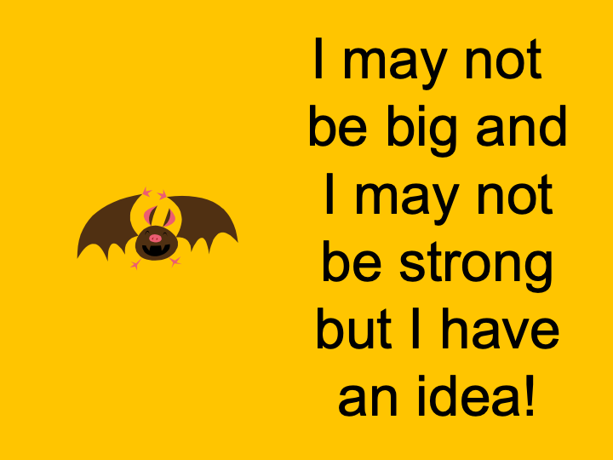

Slide 36


Slide 37


Slide 38
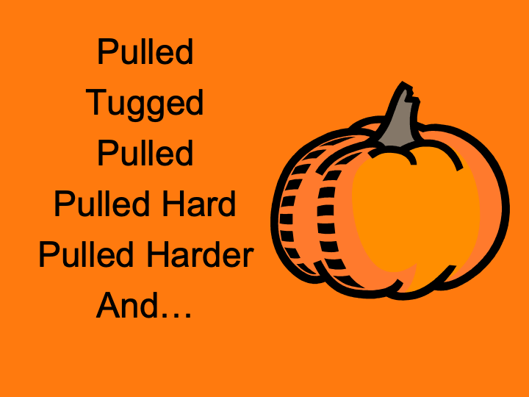

Slide 39
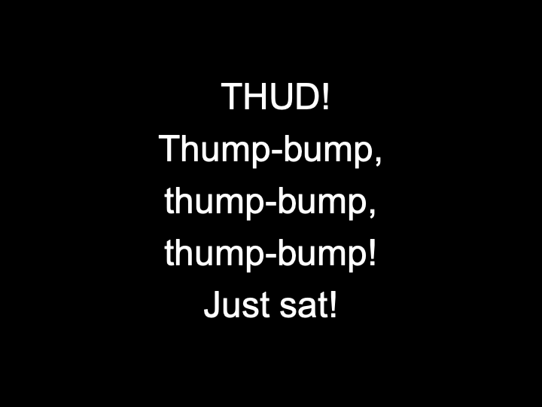

Slide 40
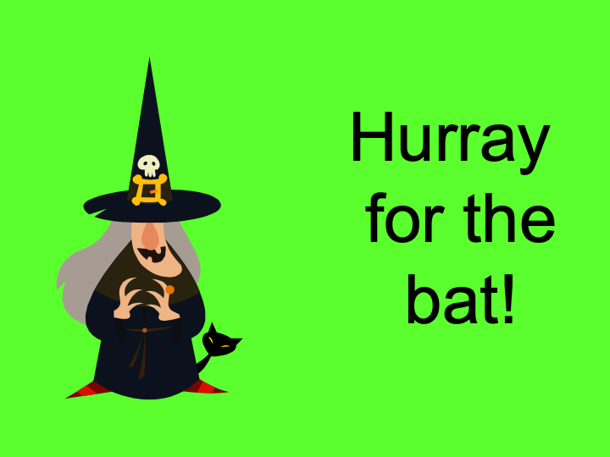

Slide 41


Slide 42
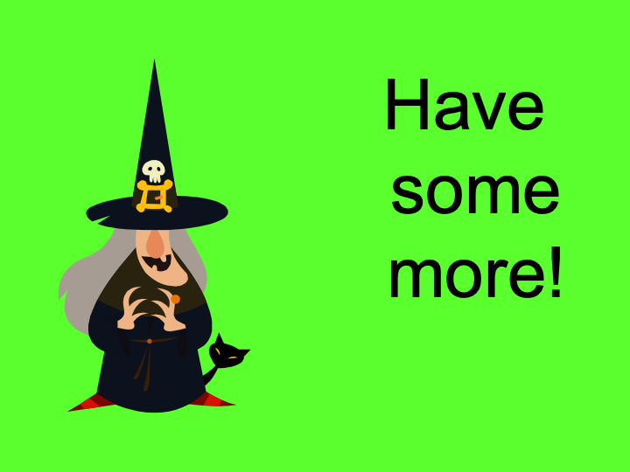

Slide 43
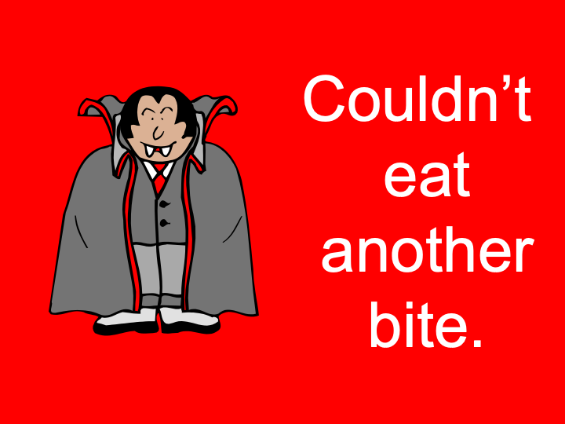

Slide 44
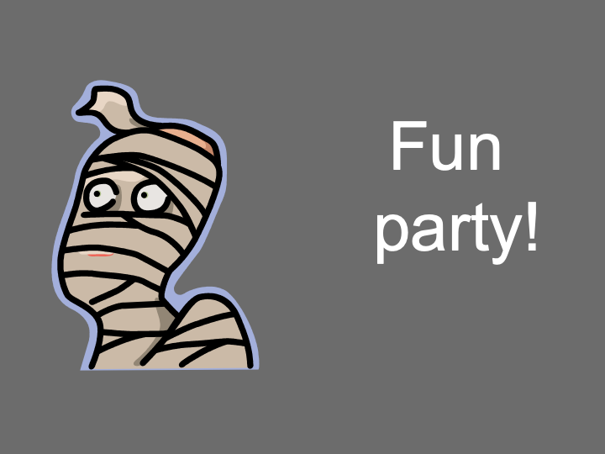

Slide 45
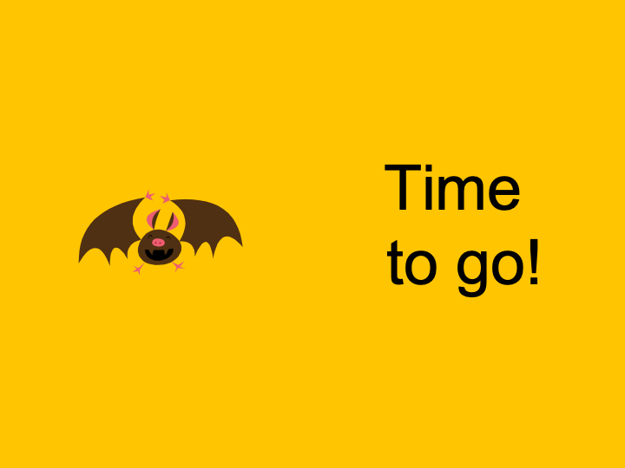

Slide 47
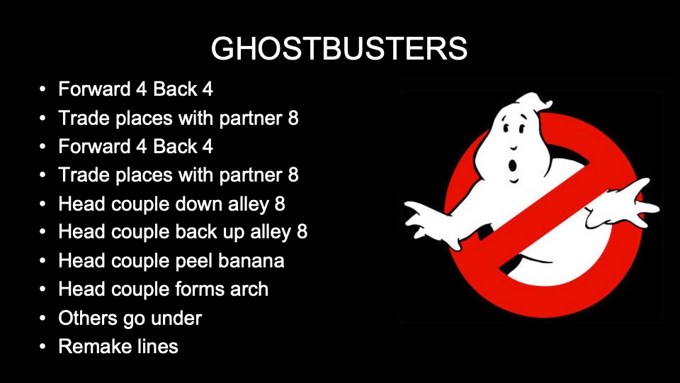


Slide 48
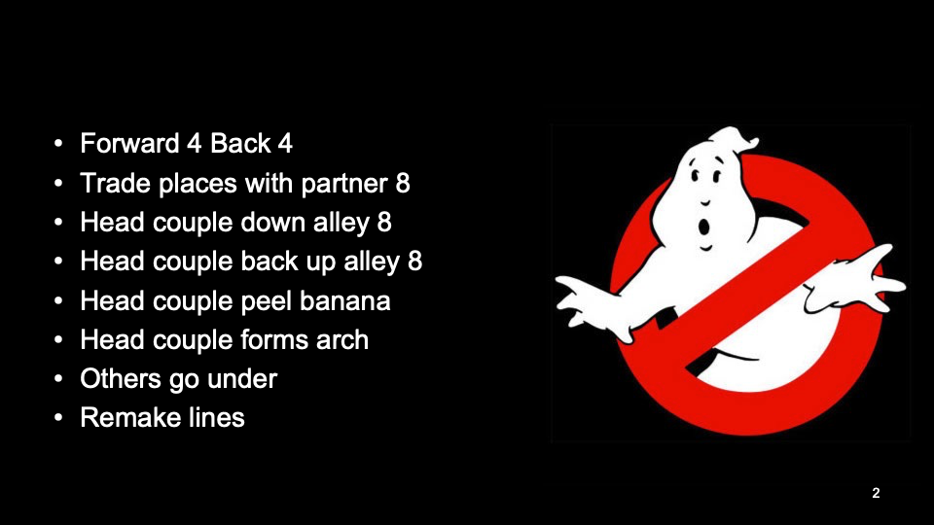

Slide 49
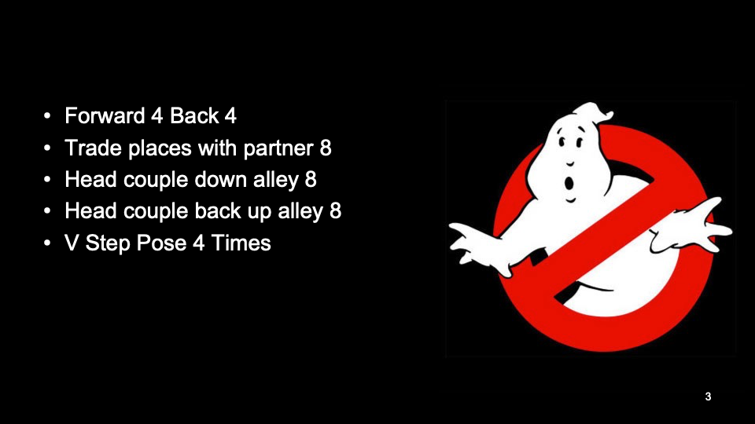

Slide 50
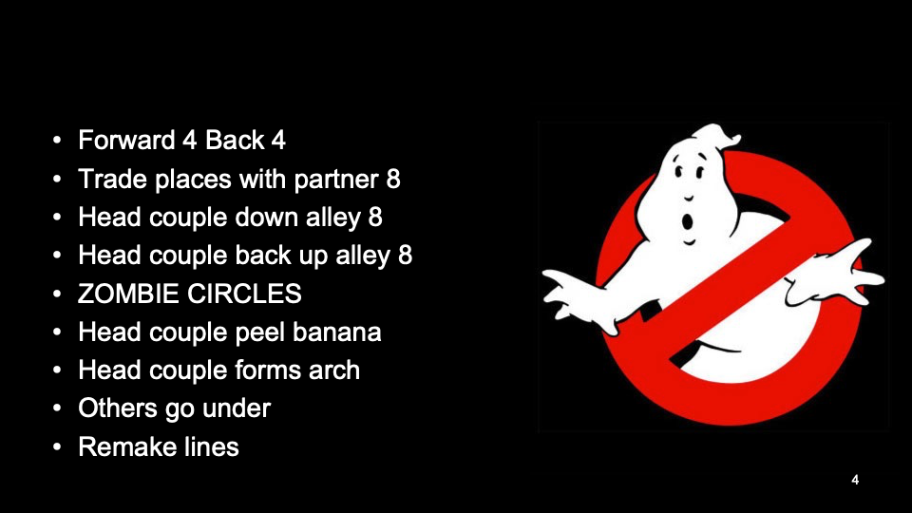

Slide 51


Slide 52
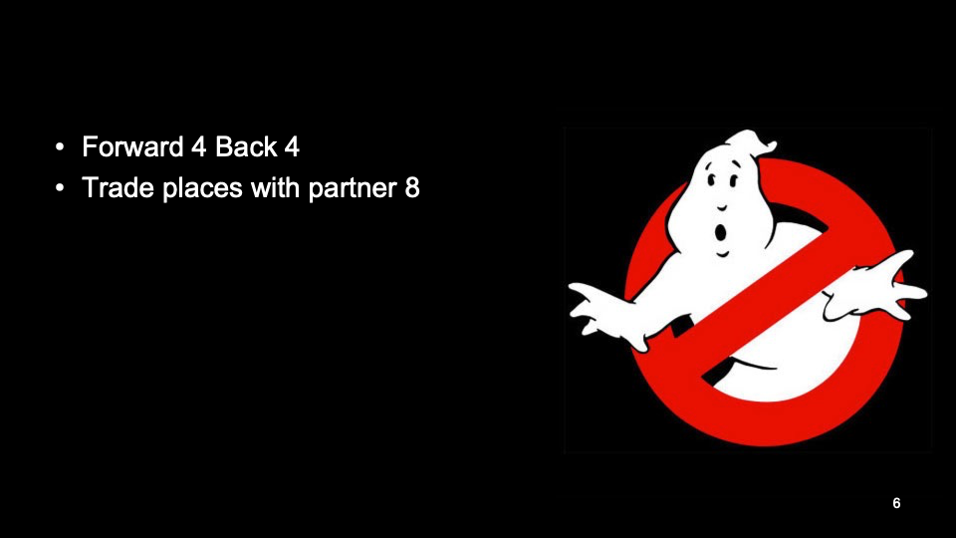

Slide 53


Slide 54
Additional Slides
I included a few additional slides that I use with my students. As we discussed, I do this story after exploring several other variations of the original Russian Folk Tale called “The Enormous Turnip.” The students also wrote their own version. I have included a slide with links to those other books. Just click on the covers!
I also mentioned that I give my students an opportunity to move like all of the characters in the story and that they participate in a “teacher in role” activity where they ask me “as the witch” several questions to try and figure out why I went out and planted another pumpkin seed. I have included theses slides as well. Enjoy.
Questions? terri_scullin@riograndeschool.org

Slide 55
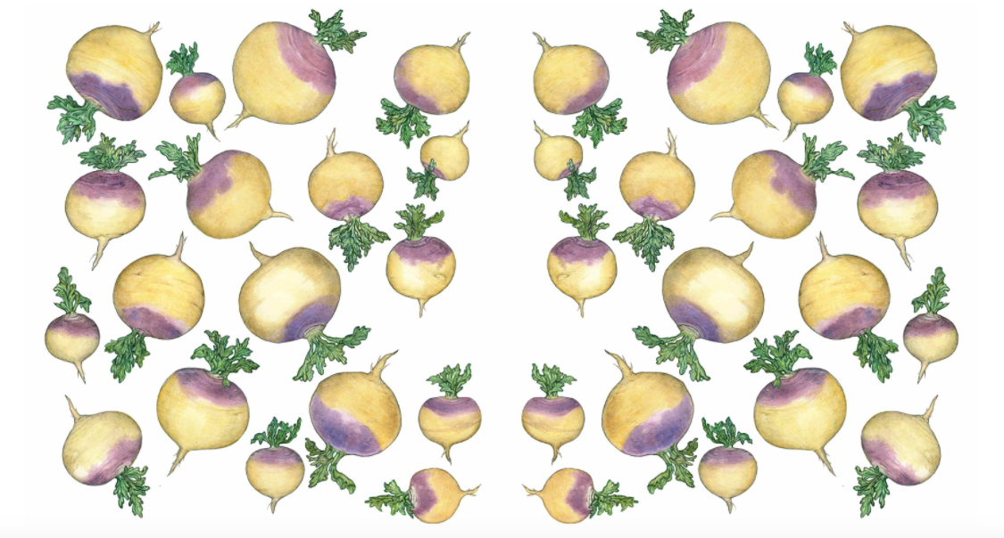




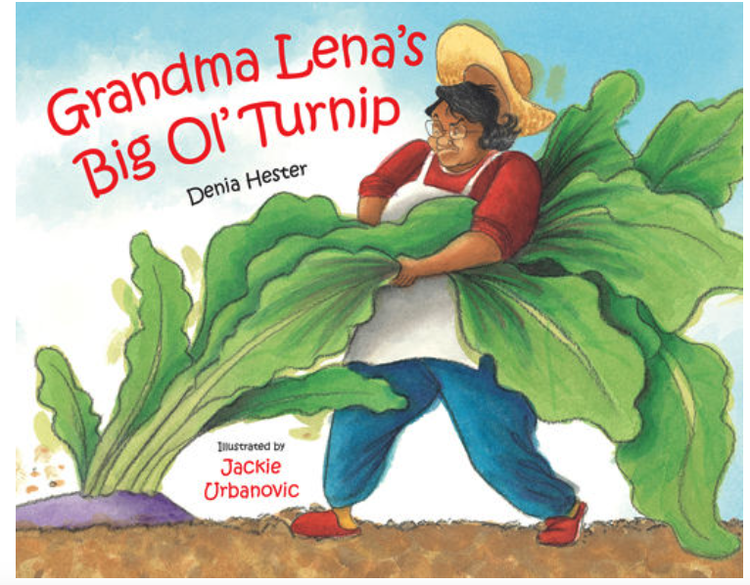
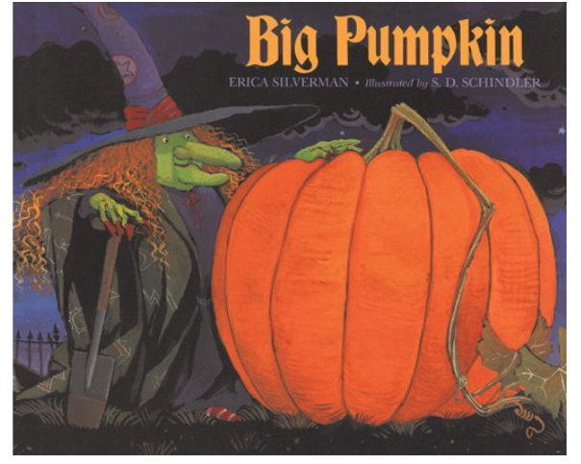
What do you notice is the same?
What do you notice is different?
Notes:
Click on the cover of the book to find out more information.

Slide 56
Can you name the characters in this version of the story?

Slide 57
Can you name the characters in this version of the story?
Witch
Ghost
Vampire
Mummy
Bat

Slide 58
Can you move like the characters in this version of the story?
Witch
Ghost
Vampire
Mummy
Bat

Slide 59
I am going to be the Witch. At the end of the story she goes out and plants another pumpkin seed. I wonder why she does that? Let’s ask her some questions and try to find out.

